Slide 1
CSE 225
Binary Search Tree

Slide 2
Binary Search Tree
BST is a binary tree with following properties:
All items in the left subtree are less than the root
All items in the right subtree are greater than or equal the root
Each subtree is itself a binary search tree
i.e. For a node with key k , every key in the left subtree is less than k and every key in the right subtree is greater than k.
K
<k
>= k

Slide 3
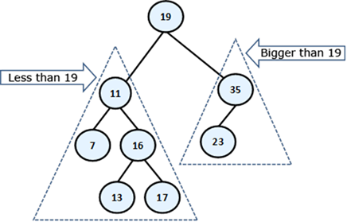
Example of BST

Slide 4
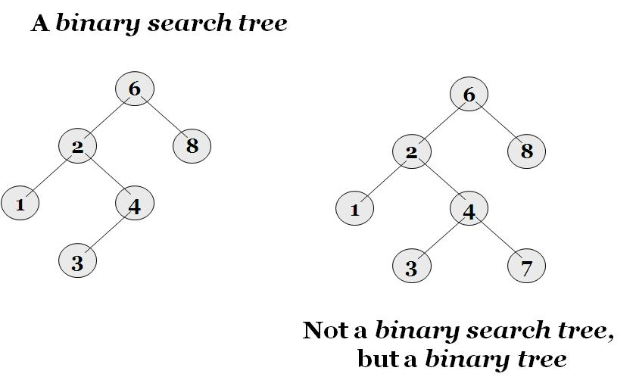
BST vs. Binary Tree

Slide 5
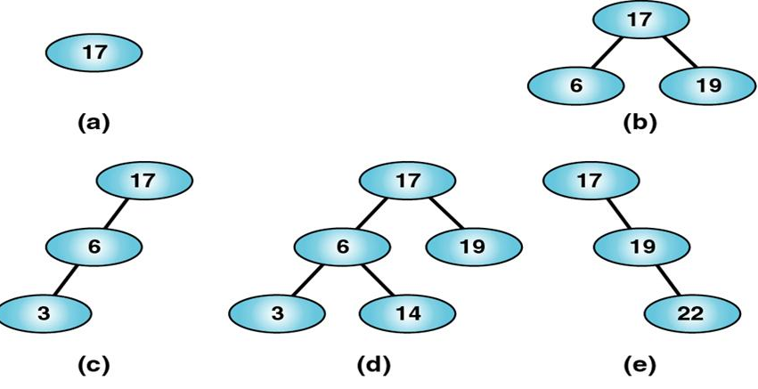
Valid BST

Slide 6
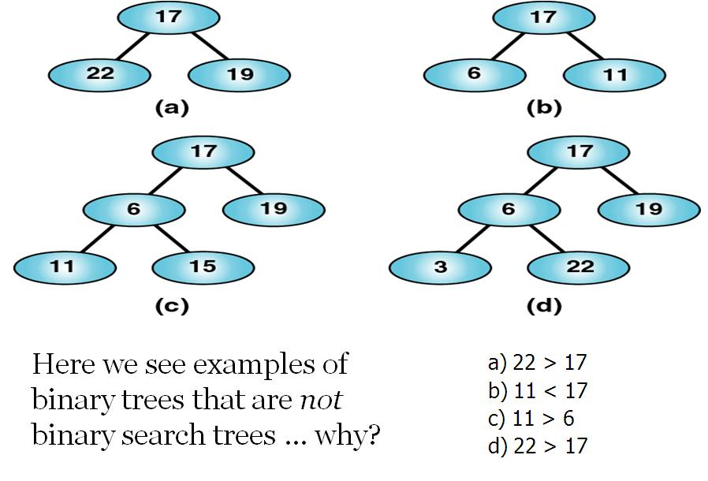
Invalid BST

Slide 7
Operations on Binary Search Tree
insert: insert a new node in the BST
search: search a node with a value in the BST
delete: delete a node from the BST
findMinimum: returns the element with the minimum value in the BST
findMaximum: returns the element with the maximum value in the BST
print: prints the values of all items in the tree, using a traversal strategy that is appropriate for the application

Slide 8
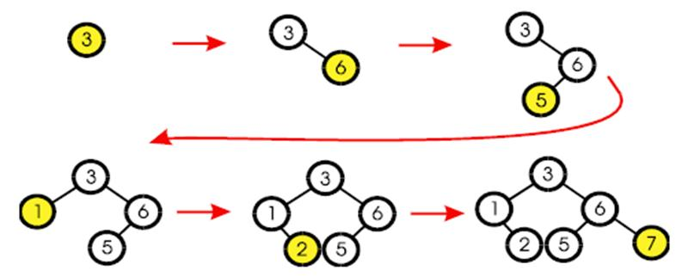
Inserting an item in BST
The first value inserted goes at the root.
Every node inserted becomes a leaf.
Insert left or right depending upon value.

Slide 9
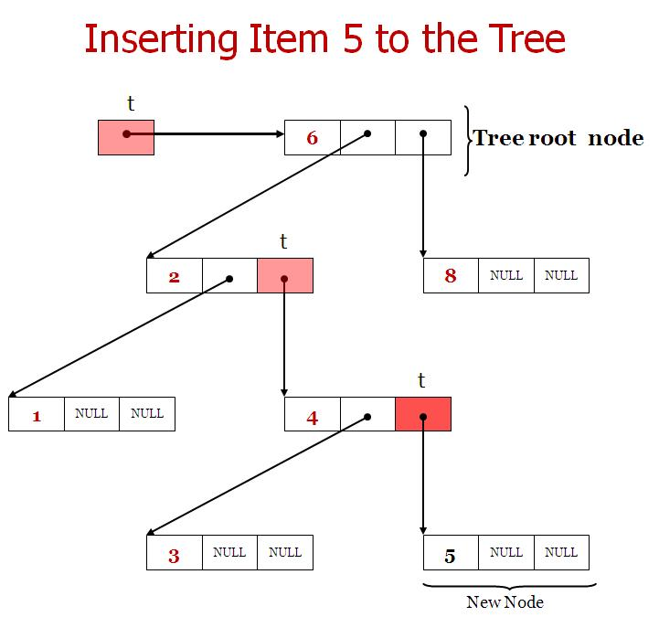
Inserting Specific Item to the tree

Slide 10
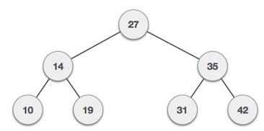
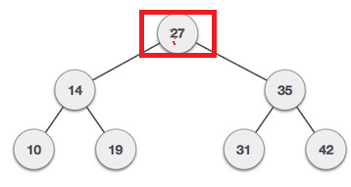
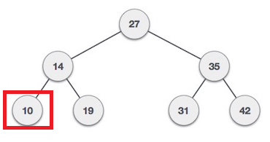
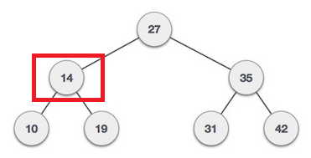
Searching Specific Item to BST
Start search from root node
If data is less than key value, search element in left subtree
Otherwise search element in right subtree.
For Example : we need to search element 10 from the BST

Slide 11
Find Smallest Node in BST
Start search from root node
Search element in left subtree

Slide 12
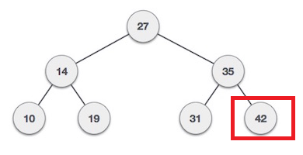
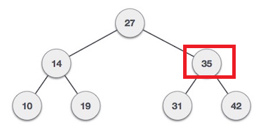
Find Maximum Node in BST
Start search from root node
Search element in right subtree

Slide 13
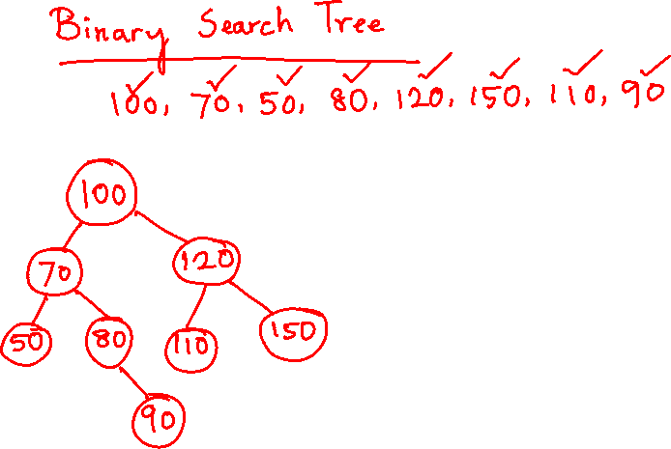

Slide 14
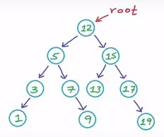
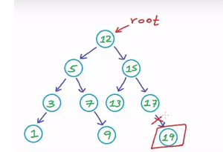
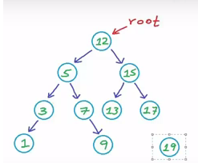
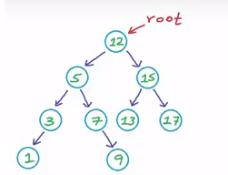
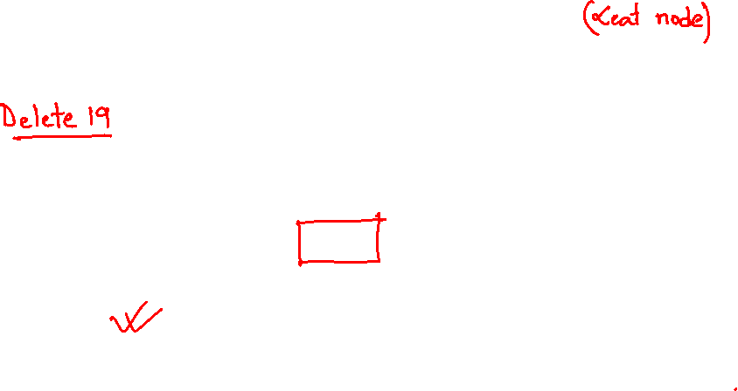
Delete a node from BST
Case 1: leaf node has no child, so this node can easily wiped out from memory
Property of BST must hold

Slide 15
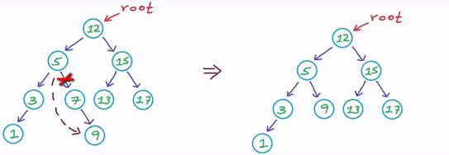
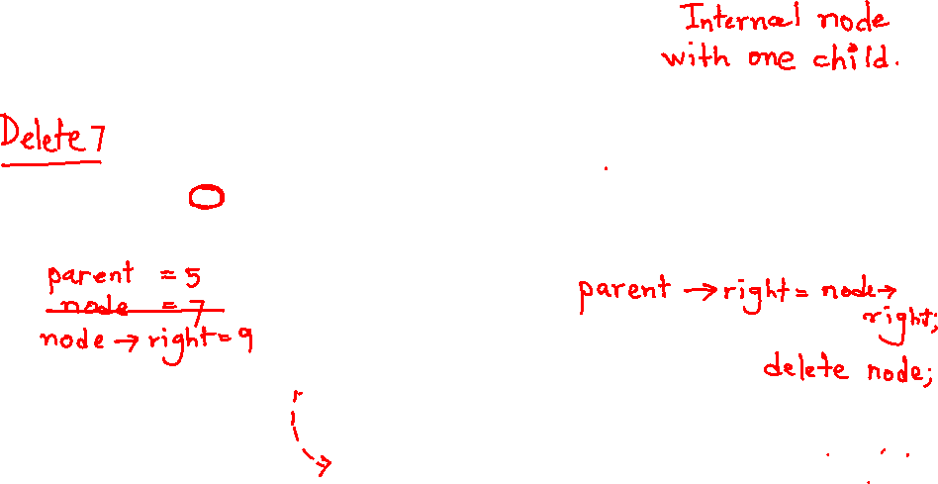
Delete a node from BST
Case 2: if node has one child (left or right ), then link the parent node with the child node and wipe out the node from memory
Property of BST must hold

Slide 16
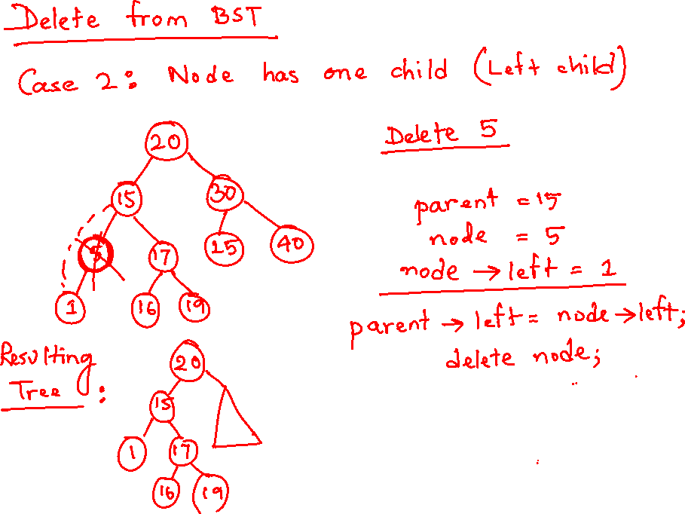

Slide 17
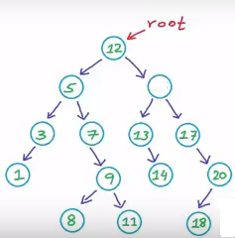
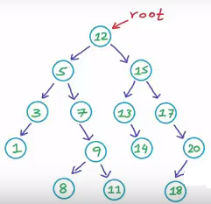
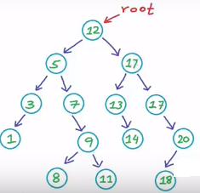
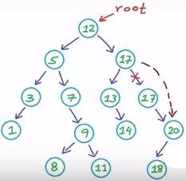
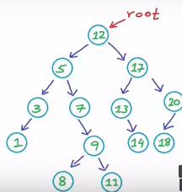
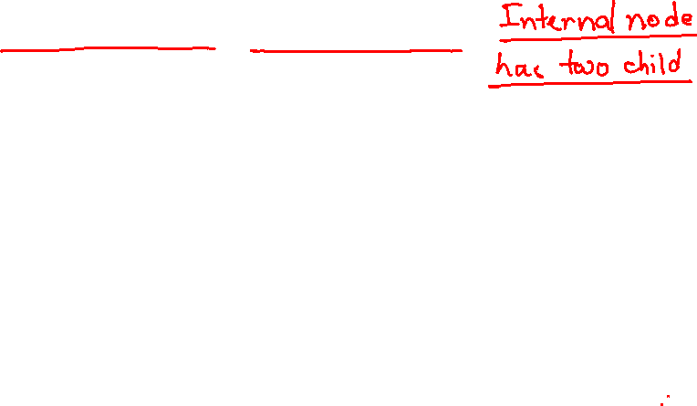
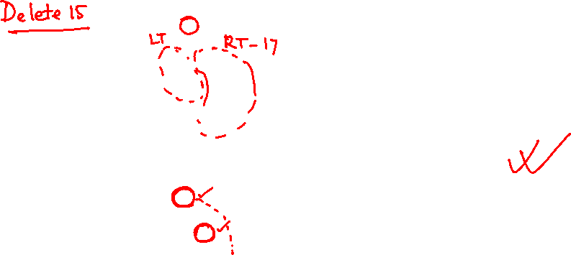
Delete a node from BST
Case 3: if node has two child then two case can be considered:
Find min node from right subtree or max node from left subtree
save the min value in the place of the node deleted
delete the dupicate value
Property of BST must hold

Slide 18
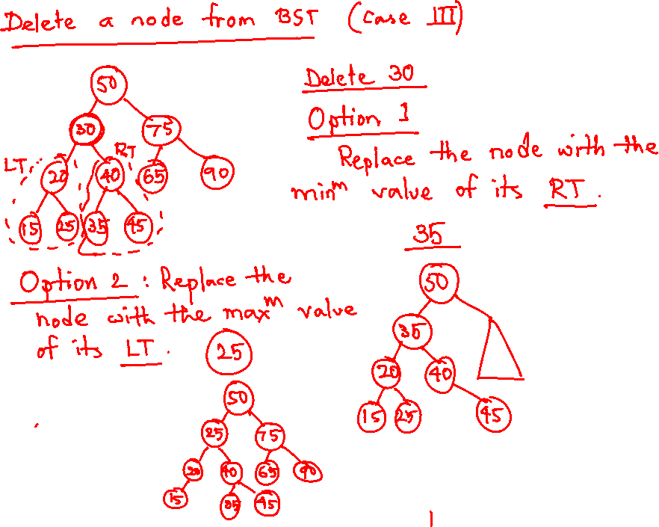

Slide 19


